Slide 1
Writing the Project proposal
Deadline: first semester 4pm Friday week 4 and worth 10% of the assessment
Approx 1500 words
Aim is to describe what the project is all about
  Give the overall goal for the project (aim)
  What are you proposing to do (objectives)
  Evaluation of relevant technical and academic material (research)
  How do you plan to complete the work (methodology)
  How to verify that objectives have been met
  List the equipment and resources required
  Identify the skills needed for the project
  Consider risk and other relevant professional issues
  Construct a realistic schedule for all tasks and activities (project plan)
You will receive proposal feedback from your supervisor
References:
Dawson C. W. (2009) Projects in Computing and Information Systems: A student guide, Pearson
Cox C. (2012) Project Handbook, Oxford Brookes Module U08096 /U08194
Notes:
Aim – Linked to the title,
Objectives – Specific achievements, something you can show, a function of the software for example
Methodology – Design approach, UML, type of IDE,
Test and evaluation – How can we show we’ve achieved the objectives. Evaluation, test on people.
Resources – Tablet, Laptop, any information?
Skills – identify skills
Risk – Process risks (project planning), product risk (Customer doesn’t like, produced something that isn’t needed/used)

Slide 2
Dissertation Proposal Content
Title Page – include your name, student number, module code, supervisor and project title
Introduction and rationale – Subject topic area, Aim and objectives, Key Issues, Brief description of activity, Relation to course and subject interest, Practical applications, Dissertation originality, Who is undertaking the work, Career interests, Intended deliverables.
Background Review - Overview of subject, Initial literature review, Summary of existing approaches and technologies, Research relating to proposed system, Background material studied with comments on relevance, Evaluation of appropriate relevant hardware and software
Methodology and Resources – Details of the proposed design process, Specification of final system, How the final system can be evaluated and tested, Risk analysis, Hardware, software or information requirements, expert help needed, Budgets
Project Plan –Gantt & PERT charts indicating dissertation development tasks and milestones, design process and deliverable dates. Allow adequate time for research, contingencies and final report preparation
References and Bibliography
The proposal forms 10% of the overall dissertation mark.
The assessment will also consider the structure, clarity, logical presentation and quality of referencing.
Notes:
Title Page – Front page
Originality – Explain why original
Intended deliverables – different version with differing functionality
Overview of subject- Java, SQL, reference to android website
Need about 10 references, only review the ones of real interest. Could be 3 – 30 lol
Methodolgy – Devices with different screen sizes and resolutions. Abit of requirement spec. How can it be tested? Probably can’t get into too much detail at this stage. Section on risk analysis, prioritise risks and start with most important. Think of mitigating measures.

Slide 3
Title page
Include your name, student number, module code, date, supervisor and project title
No need for a department front page as your assessment will be returned on an assessment form

Slide 4
Introduction and rationale
Subject topic area – indicate the subject areas to be investigated
Aim – a statement of intent, related to the project title
Objectives – planned achievements
Key Issues
Brief description of activity
Relation to course and subject interest
Practical applications
Dissertation originality
Who is undertaking the work
Career interests
Intended deliverables
Notes:
Don’t address these points religiously and in order, just include what is needed.

Slide 5
Project Aim and Objectives
1. Aim – a single general statement of intent
The aim or goal of the project will be a single overall statement of what you intend to solve or achieve
Generally this will relate to the project title
Objectives – specific and measurable planned achievements (several)
  Are derived from the project aim and contribute to its achievement
  Objectives can set realistic targets to achieve during the project.
  Can be chronological or otherwise presented logically
  Can lead to a work breakdown structure

Slide 6
Example project objectives (based on project aim )
Project Title: A neural network for predicting stock market trends
Project Aim: Develop and evaluate a neural network to predict stock market trends
Objectives:
Complete a literature search of relevant stock market prediction techniques
Develop a suitable topology and neural network model for stock market trading
Identify and collect suitable data for analysis and evaluation
Evaluate data using own constructed model, using independent statistical processing software
Critically review the neural network performance compared to other available systems

Slide 7
Background Review.
Overview of subject
Initial literature review
Summary of existing approaches (methods) and technologies
Research relating to proposed system
Background material studied with comments on relevance
Evaluation of appropriate relevant hardware and software

Slide 8
Conducting a Literature Survey for a given topic
Documentation for each source found
The search: How conducted (search engine, database, journal etc)
Reference: give a full reference of the source
Nature and reputation of the source: Give categories for the nature of the published source (peer review journal, professional/technical journal, conference proceedings, commercially based, textbook, other website etc.)
Reputation of the author: describe their published research areas and extent of publishing
Influencing work: give references for sources cited on which the work is based or is influenced by
Currency of the work
The review
Overview of content
Rationale for the work
Scope of the work
Subject categorisation
Relevant ideas, technologies, models, approaches or examples
Relevant topics to your study
Summary of results or overall contribution to the body of knowledge
Indication of further research in this area
Overall conclusion
Critical Evaluation
Discuss the approach taken and any contradictions, strengths or weaknesses
Clarity of presentation
Do conclusions follow logically from the presented work
Professionalism of presentation objective reasoned and factual or subjective and opinionated
Comparison with contemporary work
Relevance to your study
Any implications for your study
Interesting areas or questions raised for further investigation
U08055 Professional Issues and Skills
Notes:
Only do the top bit

Slide 9
Methodology and Resources
Details of the proposed design process (methodology) and development tools and environment
Specification of final system (requirement specification)
How the final system can be evaluated and tested (test plan)
Risk analysis: general and project specific risks, probability and impact
Hardware, software or information requirements (items to be obtained)
Expert help needed
Budgets

Slide 10
Project Plan
Gantt & PERT charts indicating dissertation development tasks and milestones,
Design process stages
Deliverable dates.
Allow adequate time for research, contingencies and final report preparation

Slide 11
Consider the following example Project
Design and simulate a 100Gbit/s optical communication link.
Carry out a literature review of 100Gbit/s optical systems.
Investigate the design and implementation and specify a complete system at block level with interfaces.
Investigate available simulators
Carry out a simulation of the specified system.
Based on the simulation results critically analyse the system performance

Slide 12
WBS or Activity list
Task duration dependency
10 Literature review 3
20 Prepare project Plan 1
30 System design 3 10, 20
40 Find simulation S/W 2 30
50 Prepare Interim report 2 10,20
60 System design (cont) 14 40,50
70 Learn simulation S/W 2 50
80 Simulate system 3 70
90 Prepare Presentation 2 40, 50
100 Analyse results 2 60, 80, 90
110 Prepare Final report 3 100

Slide 13
Gantt chart
2
6
10
15
19
23
27
Feb Mar Apr May June July Aug
10) Literature review
3
20) Prepare project Plan
1
3
30) System design
2
40) Find and request loan of simulation S/W
2
50) Prepare Interim report
Exam study period
14
60) System design (cont)
2
70) Learn simulation S/W
3
80) Simulate system
2
90) Prepare Presentation
2
100) Analyse results
3
110) Prepare Final report

Slide 14
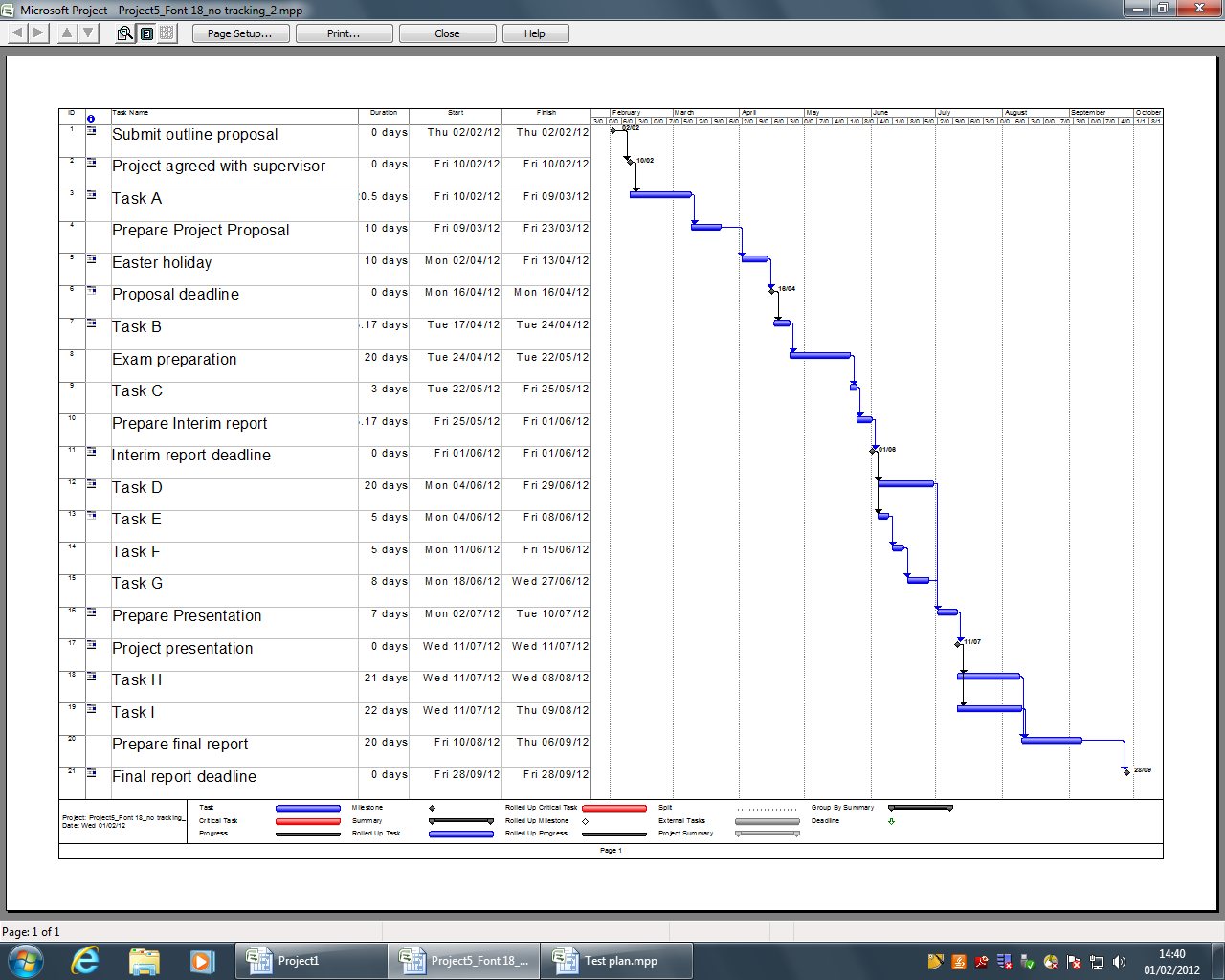
Gantt Chart – with Microsoft Project

Slide 15
Forward pass to determine earliest start and finish times
10
3
3
30
3
6
40
2
8
90
2
10
0
27
50
2
60
14
110
3
20
1
5
70
2
7
80
3
22
100
2
1
24
Activity duration dependency
10 Literature review 3
20 Prepare project Plan 1
30 System design 3 10, 20
40 Find simulation S/W 2 30
50 Prepare Interim report 2 10,20
60 System design (cont) 14 40,50
70 Learn simulation S/W 2 50
80 Simulate system 3 70
90 Prepare Presentation 2 40, 50
100 Analyse results 2 60, 80, 90
110 Prepare Final report 3 100

Slide 16
Backward pass to determine latest start and finish times, and the critical path
10
3
30
3
40
2
90
2
27 27
0 0
3 3
6 6
8 8
10 22
50
2
110
3
20
1
60
14
70
2
80
3
100
2
1 3
5 8
7 19
22 22
24 24

Slide 17
References and Bibliography
Harvard format
http://www.staffs.ac.uk/assets/harvard_referencing_examples_tcm44-39847.pdf
Example
In text citation
Wilson and Till (2008, p.60) discovered that...
Reference list
WILSON, R.T. and B.D. TILL, 2008. Airport advertising effectiveness: an exploratory field study. Journal of advertising, 37(1), 59-72
IEEE format
IEEE Style Manual: http://www.ieee.org/documents/stylemanual.pdf
Example
In text citation
"The theory was first put forward in 1961 [1]."
"Several recent studies [3, 4, 15, 16] have suggested that..."
"For an example, see [7]."
Reference list
[1] R. E. Kalman, “New results in linear filtering and prediction theory,” J. Basic Eng., ser. D, vol. 83, pp. 95-108, Mar. 1961.
[2] J. U. Buncombe, “Infrared navigation—Part I: Theory,” IEEE Trans. Aerosp. Electron. Syst., vol. AES-4, pp. 352–377, Sept. 1944.

Slide 18
Project Proposal Assessment (10% of marks)
Criteria | marks awarded | Comments
Introduction and Aims - relation to field and interests, purpose, practical applications, outcomes, deliverables, project originality | /20
Research - overview of subject, evaluation of existing material, research relevance, use of references | /20
Methodology – development approach resource requirements, project plan: activities and milestones (Gantt chart), risk analysis, testing and evaluation | /40
Report Writing document structure, clarity & logical presentation, citations and references. | /20
Overall Proposal mark % | Proposal mark as 0-10 | Overall Comments
% | /10

